Slide 1
Determine the Diagonals
With thanks to Ptolemy

Slide 2





Determine the Diagonals
Calculate the lengths of the diagonals in the quadrilateral shown.
Comparing your answer with that of others (who should have different quadrilaterals) can you make a hypothesis about your result?
Can you prove it?
$$60°$$
$$2.8$$
$$2.8$$
$$2$$
$$1.2$$
(Not to scale)

Slide 3

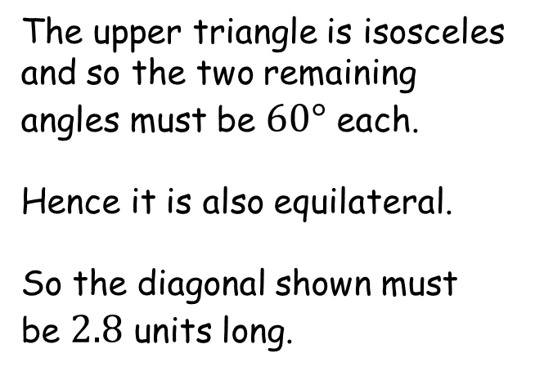


Determine the Diagonals
The upper triangle is isosceles and so the two remaining angles must be $60°$ each.
Hence it is also equilateral.
So the diagonal shown must be $2.8$ units long.
$$60°$$
$$2.8$$
$$2.8$$
$$2.8$$
$$60°$$
$$60°$$
$$2$$
$$1.2$$
(Not to scale)

Slide 4
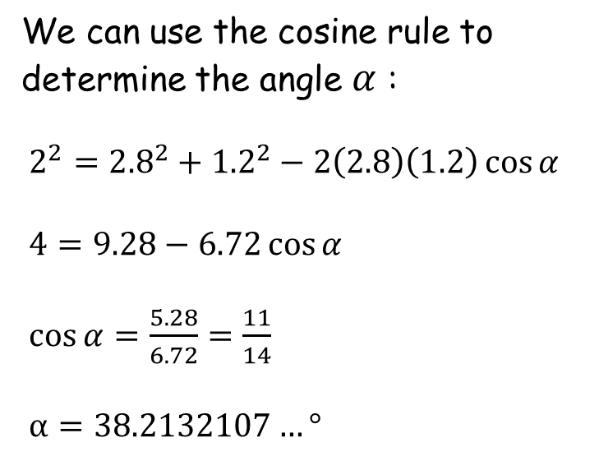

Determine the Diagonals
We can use the cosine rule to determine the angle $α$ :
$2^{2}={2.8}^{2}+{1.2}^{2}−2\left(2.8\right)\left(1.2\right)\cos{α}$
$4=9.28−6.72\cos{α}$
$\cos{α}=\frac{5.28}{6.72}=\frac{11}{14}$
$α=38.2132107…°$
$$60°$$
$$2.8$$
$$2.8$$
$$2.8$$
$$60°$$
$$60°$$
$$α$$
$$2$$
$$1.2$$
(Not to scale)

Slide 5

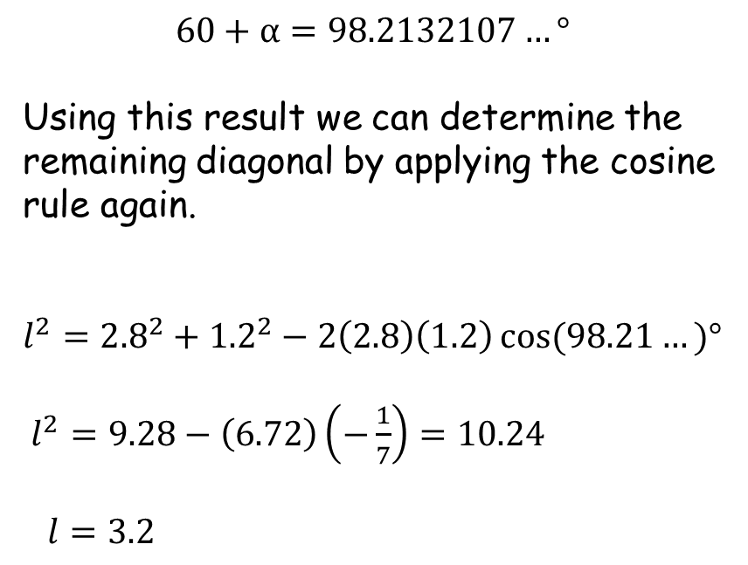

Determine the Diagonals
$$60+α=98.2132107…°$$
Using this result we can determine the remaining diagonal by applying the cosine rule again.
$l^{2}={2.8}^{2}+{1.2}^{2}−2\left(2.8\right)\left(1.2\right)\cos{(98.21…)°}$
$l^{2}=9.28−\left(6.72\right)\left(−\frac{1}{7}\right)=10.24$
$l=3.2$
$$60°$$
$$2.8$$
$$2.8$$
$$l$$
$$98.21…°$$
$$2$$
$$1.2$$
(Not to scale)

Slide 6



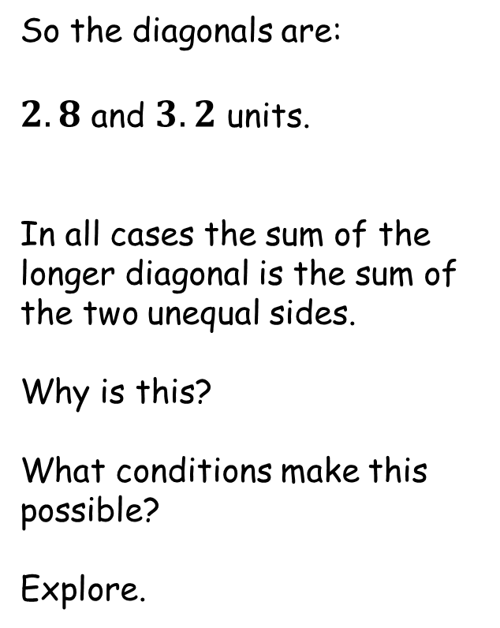
Determine the Diagonals
So the diagonals are:
$2.8$ and $3.2$ units.
In all cases the sum of the longer diagonal is the sum of the two unequal sides.
Why is this?
What conditions make this possible?
Explore.
$$60°$$
$$2.8$$
$$2.8$$
$$3.2$$
$$2.8$$
$$2$$
$$1.2$$
(Not to scale)
Hint: What’s the angle opposite $60°$ ?

Slide 7
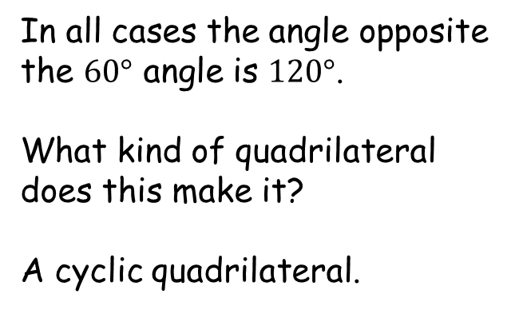

Determine the Diagonals
In all cases the angle opposite the $60°$ angle is $120°$.
What kind of quadrilateral does this make it?
A cyclic quadrilateral.
$$60°$$
$$120°$$

Slide 8

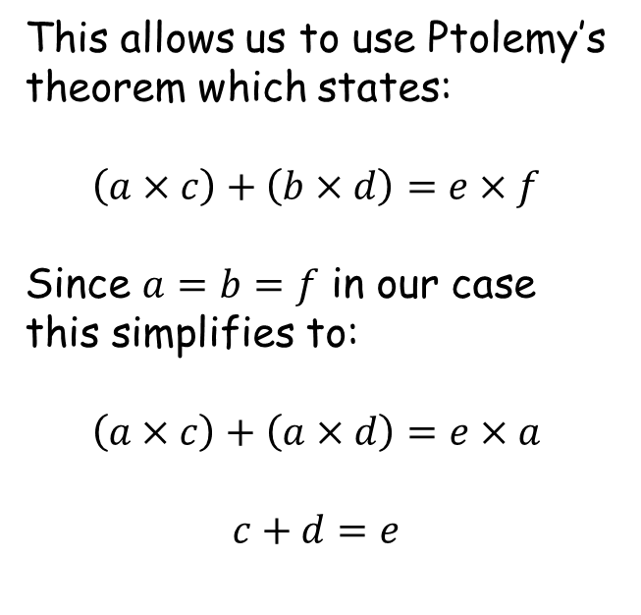





Determine the Diagonals
This allows us to use Ptolemy’s theorem which states:
$$\left(a×c\right)+\left(b×d\right)=e×f$$
Since $a=b=f$ in our case this simplifies to:
$$\left(a×c\right)+\left(a×d\right)=e×a$$
$$c+d=e$$
$$60°$$
$$b$$
$$a$$
$$e$$
$$f$$
$$120°$$
$$c$$
$$d$$

Slide 10
Note to Teacher
Add the two lower sides to get the “vertical” diagonal.
The Geogebra file can be used to demonstrate the answer.
Move points A or B to get the upper side lengths you desire then
move point P to demonstrate how the solution is invariant.
Year 12 or 13 could do this without calculators, perhaps?

Slide 11
RESOURCES

Slide 12





Determine the Diagonals
Calculate the lengths of the diagonals in the quadrilateral shown.
Comparing your answer with that of others (who should have different quadrilaterals) can you make a hypothesis about your result?
Can you prove it?
$$60°$$
$$3.1$$
$$3.1$$
$$2.4$$
$$1.1$$
(Not to scale)
SIC_53

Slide 13



Determine the Diagonals
Calculate the lengths of the diagonals in the quadrilateral shown.
Comparing your answer with that of others (who should have different quadrilaterals) can you make a hypothesis about your result?
Can you prove it?
$$60°$$
$$3.25$$
$$3.25$$
$$2$$
$$1.75$$
(Not to scale)
SIC_53

Slide 14




Determine the Diagonals
Calculate the lengths of the diagonals in the quadrilateral shown.
Comparing your answer with that of others (who should have different quadrilaterals) can you make a hypothesis about your result?
Can you prove it?
$$60°$$
$$3.8$$
$$3.8$$
$$3.2$$
$$1$$
(Not to scale)
SIC_53

Slide 15



Determine the Diagonals
Calculate the lengths of the diagonals in the quadrilateral shown.
Comparing your answer with that of others (who should have different quadrilaterals) can you make a hypothesis about your result?
Can you prove it?
$$60°$$
$$3.9$$
$$3.9$$
$$2.4$$
$$2.1$$
(Not to scale)
SIC_53

Slide 16




Determine the Diagonals
Calculate the lengths of the diagonals in the quadrilateral shown.
Comparing your answer with that of others (who should have different quadrilaterals) can you make a hypothesis about your result?
Can you prove it?
$$60°$$
$$3.95$$
$$3.95$$
$$2.55$$
$$2$$
(Not to scale)
SIC_53

Slide 17




Determine the Diagonals
Calculate the lengths of the diagonals in the quadrilateral shown.
Comparing your answer with that of others (who should have different quadrilaterals) can you make a hypothesis about your result?
Can you prove it?
$$60°$$
$$4.2$$
$$4.2$$
$$3$$
$$1.8$$
(Not to scale)
SIC_53

Slide 18




Determine the Diagonals
Calculate the lengths of the diagonals in the quadrilateral shown.
Comparing your answer with that of others (who should have different quadrilaterals) can you make a hypothesis about your result?
Can you prove it?
$$60°$$
$$4.65$$
$$4.65$$
$$3.6$$
$$1.65$$
(Not to scale)
SIC_53

Slide 19




Determine the Diagonals
Calculate the lengths of the diagonals in the quadrilateral shown.
Comparing your answer with that of others (who should have different quadrilaterals) can you make a hypothesis about your result?
Can you prove it?
$$60°$$
$$4.75$$
$$4.75$$
$$4$$
$$1.25$$
(Not to scale)
SIC_53

Slide 20




Determine the Diagonals
Calculate the lengths of the diagonals in the quadrilateral shown.
Comparing your answer with that of others (who should have different quadrilaterals) can you make a hypothesis about your result?
Can you prove it?
$$60°$$
$$5.15$$
$$5.15$$
$$3.85$$
$$2$$
(Not to scale)
SIC_53

Slide 21



Determine the Diagonals
Calculate the lengths of the diagonals in the quadrilateral shown.
Comparing your answer with that of others (who should have different quadrilaterals) can you make a hypothesis about your result?
Can you prove it?
$$60°$$
$$5.6$$
$$5.6$$
$$4$$
$$2.4$$
(Not to scale)
SIC_53

Slide 22



Determine the Diagonals
Calculate the lengths of the diagonals in the quadrilateral shown.
Comparing your answer with that of others (who should have different quadrilaterals) can you make a hypothesis about your result?
Can you prove it?
$$60°$$
$$6.5$$
$$6.5$$
$$4$$
$$3.5$$
(Not to scale)
SIC_53

Slide 23



Determine the Diagonals
Calculate the lengths of the diagonals in the quadrilateral shown.
Comparing your answer with that of others (who should have different quadrilaterals) can you make a hypothesis about your result?
Can you prove it?
$$60°$$
$$7.35$$
$$7.35$$
$$5.85$$
$$2.4$$
(Not to scale)
SIC_53

Slide 24



Determine the Diagonals
Calculate the lengths of the diagonals in the quadrilateral shown.
Comparing your answer with that of others (who should have different quadrilaterals) can you make a hypothesis about your result?
Can you prove it?
$$60°$$
$$7.6$$
$$7.6$$
$$6.4$$
$$2$$
(Not to scale)
SIC_53

Slide 25




Determine the Diagonals
Calculate the lengths of the diagonals in the quadrilateral shown.
Comparing your answer with that of others (who should have different quadrilaterals) can you make a hypothesis about your result?
Can you prove it?
$$60°$$
$$8.6$$
$$8.6$$
$$7$$
$$2.6$$
(Not to scale)
SIC_53

Slide 26




Determine the Diagonals
Calculate the lengths of the diagonals in the quadrilateral shown.
Comparing your answer with that of others (who should have different quadrilaterals) can you make a hypothesis about your result?
Can you prove it?
$$60°$$
$$9.75$$
$$9.75$$
$$6$$
$$5.25$$
(Not to scale)
SIC_53

Slide 27




Determine the Diagonals
Calculate the lengths of the diagonals in the quadrilateral shown.
Comparing your answer with that of others (who should have different quadrilaterals) can you make a hypothesis about your result?
Can you prove it?
$$60°$$
$$10.3$$
$$10.3$$
$$7.7$$
$$4$$
(Not to scale)
SIC_53

Slide 28




Determine the Diagonals
Calculate the lengths of the diagonals in the quadrilateral shown.
Comparing your answer with that of others (who should have different quadrilaterals) can you make a hypothesis about your result?
Can you prove it?
$$60°$$
$$10.9$$
$$10.9$$
$$9.5$$
$$2.4$$
(Not to scale)
SIC_53

Slide 29




Determine the Diagonals
Calculate the lengths of the diagonals in the quadrilateral shown.
Comparing your answer with that of others (who should have different quadrilaterals) can you make a hypothesis about your result?
Can you prove it?
$$60°$$
$$12.25$$
$$12.25$$
$$9.75$$
$$4$$
(Not to scale)
SIC_53

Slide 30



Determine the Diagonals
Calculate the lengths of the diagonals in the quadrilateral shown.
Comparing your answer with that of others (who should have different quadrilaterals) can you make a hypothesis about your result?
Can you prove it?
$$60°$$
$$15.2$$
$$15.2$$
$$12.8$$
$$4$$
(Not to scale)
SIC_53

Slide 31



Determine the Diagonals
Calculate the lengths of the diagonals in the quadrilateral shown.
Comparing your answer with that of others (who should have different quadrilaterals) can you make a hypothesis about your result?
Can you prove it?
$$60°$$
$$20.15$$
$$20.15$$
$$17.85$$
$$4$$
(Not to scale)
SIC_53

